Slide 1

Risk Management
Terry Butrym, Liability Manager
Kristin Morency, Liability Analyst
Notes:
Good morning. My name is Terry Butrym and I work in the Risk Management Department as the Liability Manager. Thank you so much for inviting me to speak with you today.

Slide 2
County Vehicle Accident Training
WHAT SHOULD YOU DO IF YOU ARE IN AN ACCIDENT?
WHAT ARE THE PROPER FORMS TO FILL OUT?
HOW TO TAKE GREAT PHOTOS?
Notes:
Today we are going to discuss the pest practices if you are in an accident while driving a County Bus. We will also touch on what to do if you are in an accident while at work in your own vehicle.
I’m sure if I took a poll on who has been in an auto accident most of you would raise your hand. There are many similarities on what you will do after an accident while driving a County bus versus your own vehicle, but there are significant differences as well. Today we will focus on the specific forms to fill out and discuss how to take great pictures at the scene.

Slide 3
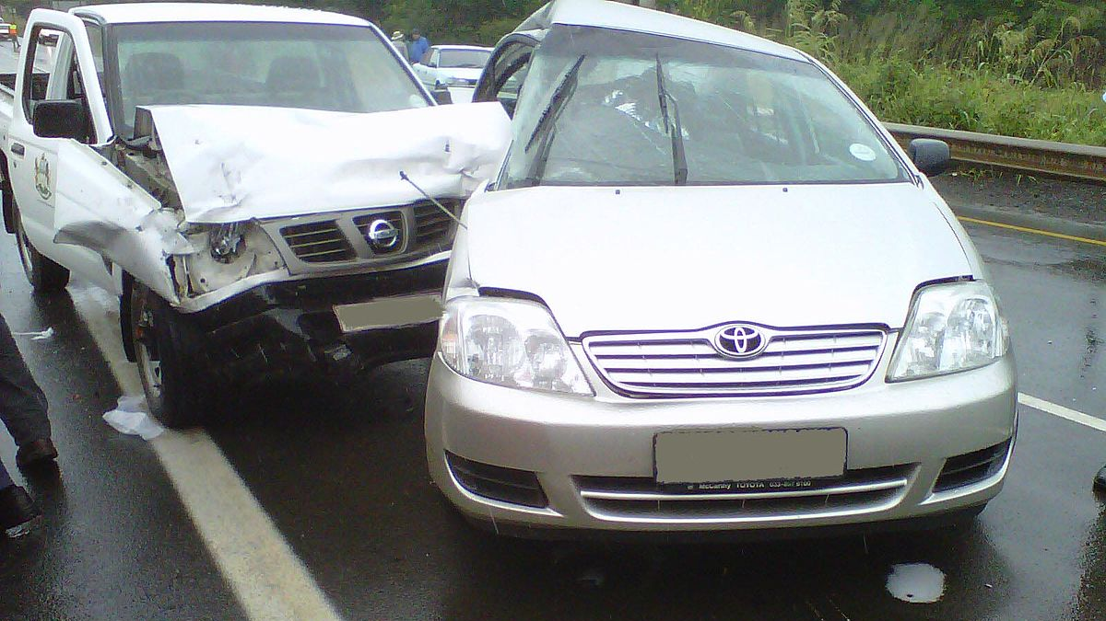
AVOID ACCIDENTS!
Notes:
Now it goes without saying, the goal is for all employees to drive safely and avoid getting into an accident.
Reducing at fault claims lowers the County’s insurance premiums and decreases the claims and litigation costs.

Slide 4
What is the most common type of accident that occurs in a County vehicle?
A. Rear-end accidents
C. Side swipe accidents
B. Unsafe backing
Notes:
Time for our first question…. What does everyone think the most common type of accident that occurs in County Vehicles?
Rear end accidents
Side swipe accidents
Unsafe backing accidents

Slide 5
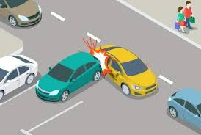
If you guessed
C, you are correct.
Rear-end accidents
Unsafe backing
Side swipe accidents
Notes:
If you guessed C—unsafe backing accidents, you are correct. We all have a lot going on and it’s easy to become distracted. It’s best practice before getting into your County vehicle to check your surroundings to make sure there is nothing in your way prior to backing.

Slide 6
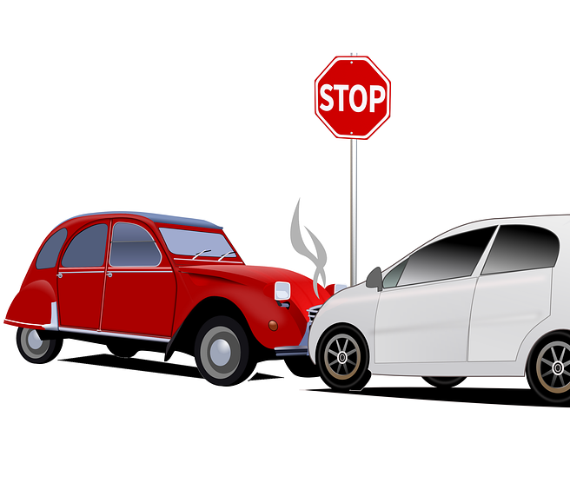
IN AN ACCIDENT?
Check for Injuries
Call the CHP
Call your Manager
Grab an accident information packet from the glove box
Notes:
If you do find yourself in an accident, here’s what is recommended:
First, check to make sure you and your passengers are not injured.
Next, contact your manager and the California Highway Patrol (CHP).
The CHP may not show up depending on their availability, however, by calling them you have created a record that you reported the accident. This is important especially if the other party makes a claim.
In your glove box, you will find the Accident Information Packet.

Slide 7
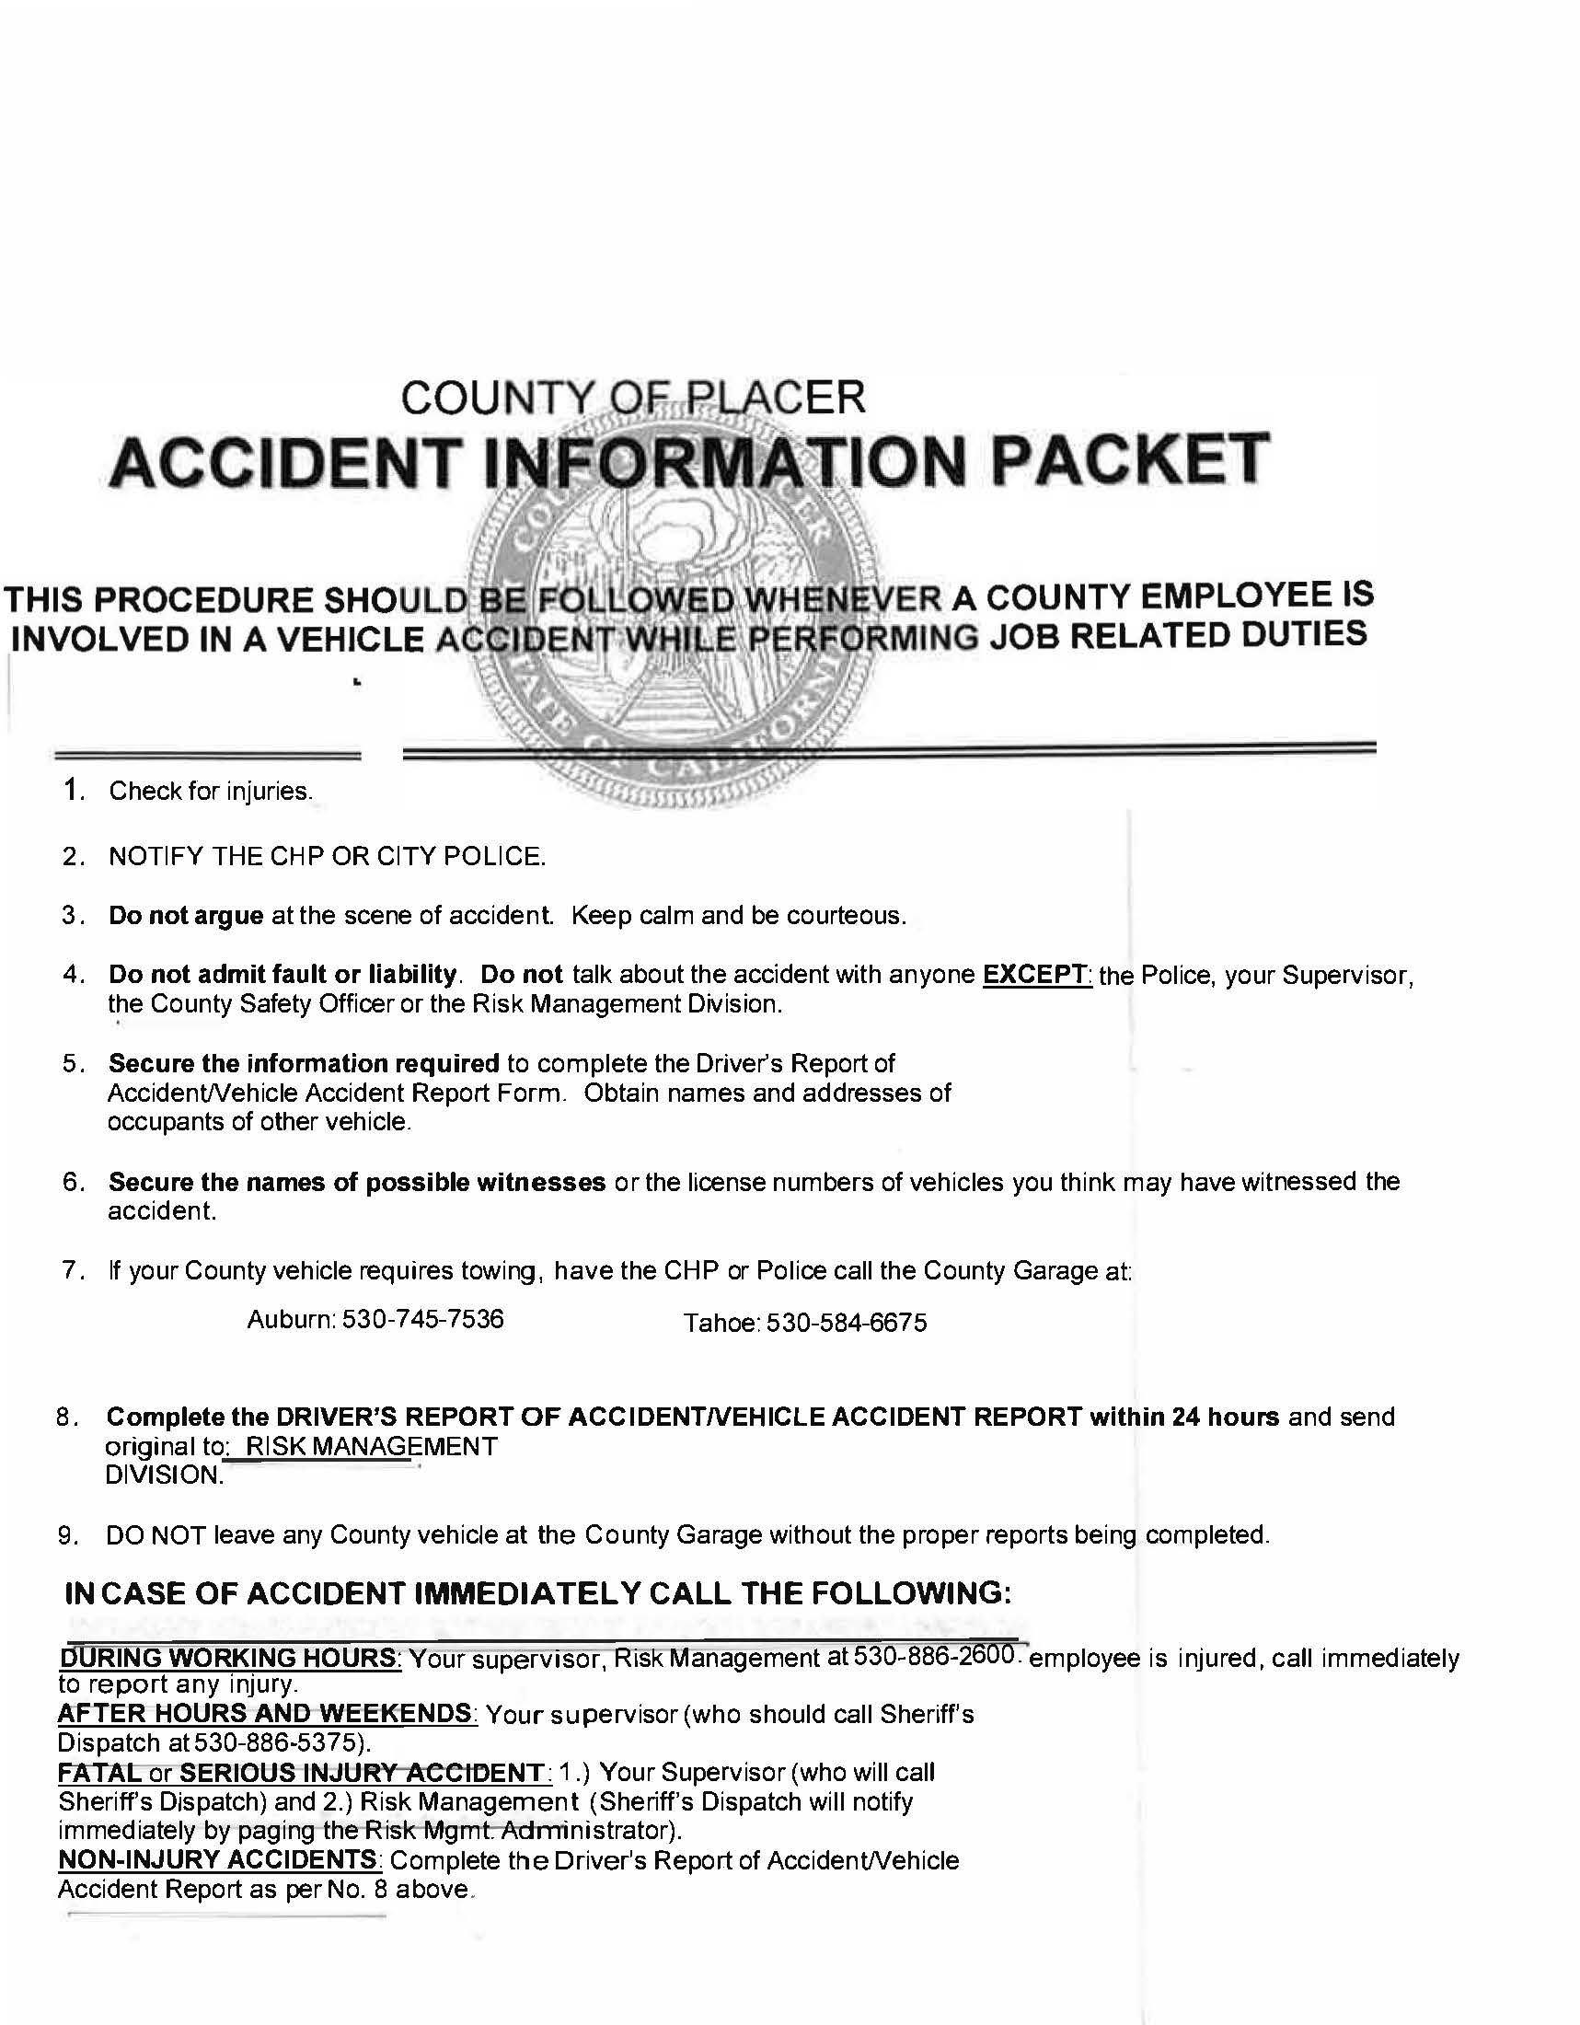
ACCIDENT INFORMATION PACKET
Notes:
This is a picture of the front of the packet that is located in all County vehicles. Inside this packet are the forms you will need to complete and submit when involved in an accident.
At the scene, remember you are a Placer County employee so you will only want to give out your working information such as your work phone number and work address and not your home address or phone number.
We also recommend not discussing the accident with the other party or admitting fault at the scene. Instead, give them Risk Management’s information which is located n the back of the packet and our business cards also located in the packet.
Now if you are involved in an accident in your own vehicle while working, you will share with the other driver your personal insurance information as your insurance will be primary.

Slide 8
Self Insurance Letter
Notes:
When speaking with the other driver they will most likely ask about your insurance information. The county is a little different in that we are self-insured. You can see on the screen a copy of our Self Insurance Letter which is also in your packet. Please feel free to give this letter to the other party if they ask.
Now if you are involved in an accident in your own vehicle while working, you will give the other driver your personal insurance information as your insurance will be primary.

Slide 9
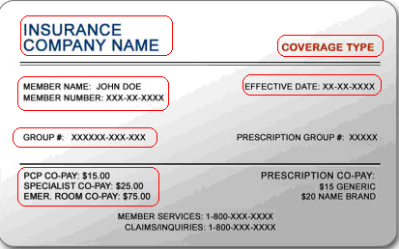
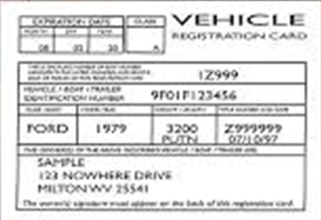
Information to obtain from the other driver–
Driver’s license
Insurance card
Auto registration
Notes:
It is very important after the accident to obtain the following information from the other driver:
Their insurance card
Their registration
And their driver’s license
We highly recommend taking photos of this information with your cell phone. This ensures accuracy and is quicker than writing all the information down.

Slide 10
Bus Accident Report-page 1
Notes:
Also in your packet is the Bus Accident Report for you to complete. It is pretty self explanatory. This is something you will fill out either at the scene of the accident or right when you get back to the office. There is space for your information and the other party’s information. When filling out the address and phone number, remember to put your work information. This is an internal document, so you will not share it with the other party or have them fill out any portion of it.

Slide 11
Bus Accident Report – page 2
Notes:
On the second page there is room to describe what happened and space to draw a diagram.
After it is completed, give it to your manager to review and sign. They will forward it to us.
Now we want to share some examples:

Slide 12

Notes:
This is an example of a not so helpful way to fill out the accident description and diagram. The facts are not clear and the diagram is confusing.

Slide 13

Notes:
This next slide shows a great example
The facts are clear and concise
The streets are labeled as ae the cars.
And it show the point of impact.
Anyone looking at this can see what happened and most likely who is at fault.

Slide 14
Incident Report Form
.
Notes:
Here is the Incident Repot Form. If you are involved in a non-vehicle accident this is the form you would fill out. And example would be if you tripped over a curb and fell while working. Once completed, you will have your manager review, sign, and they will email it to us.

Slide 15
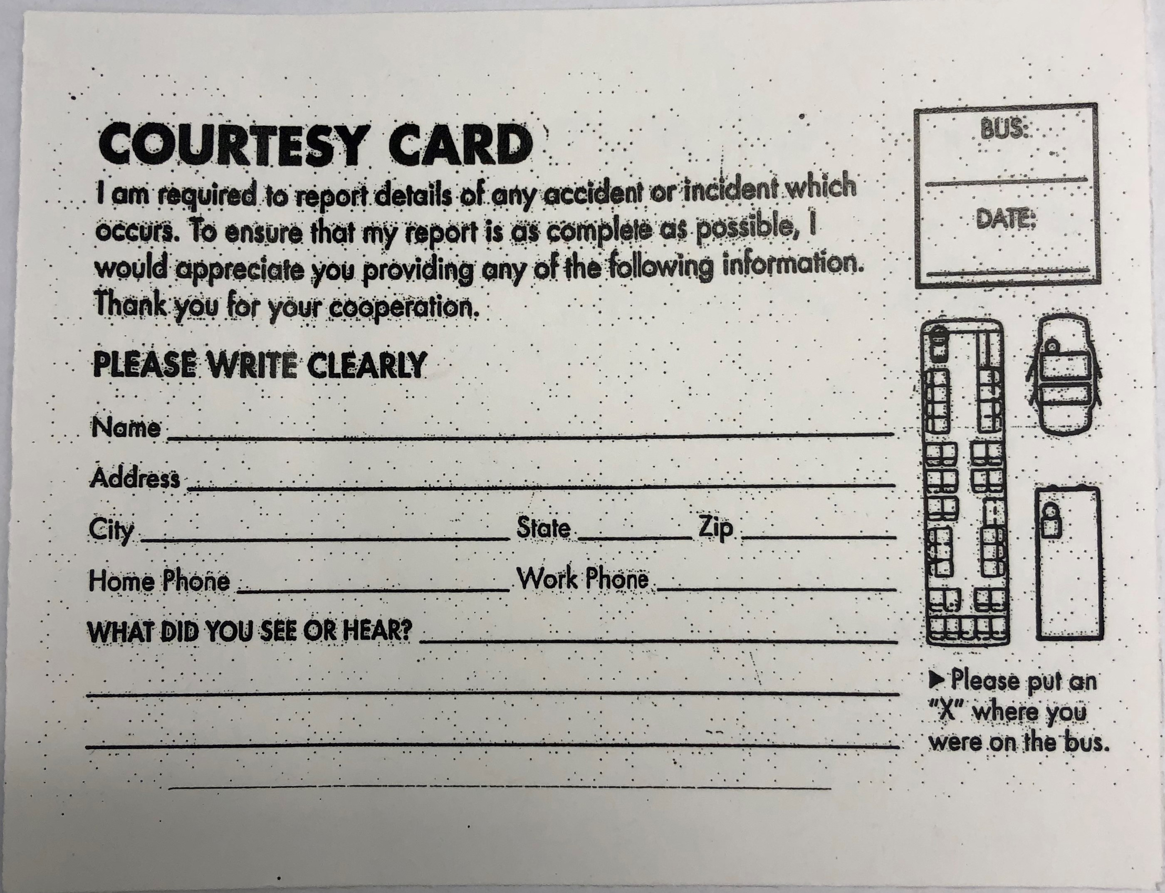
Courtesy Card
.
Notes:
This is a Courtesy card that you will want to give to all of the passengers that are on the bus at the time of the accident. Please have them fill it out while still on the bus and give it to you before getting off the bus.

Slide 16

The More Photos the Better
4 Corners of the vehicle standing 5 feet back
Front & back of the vehicle, including the license plate
Side of the vehicle
Damaged area close up & far away
The entire scene
Notes:
I talked a little earlier about using your cell phone to take photos of the other person’s information. It is also beneficial to use your cell phone to take pictures of the cars and scene as this helps with our investigation. Now, if possible, we recommend taking pictures of the other person’s car first. It’s best to take photos from every corner standing about 5 feet from the car. Then, take pictures of the front and back of the car including the license plate. You can then focus on the damaged area, from close and far away. Finally take photos of the scene, and of the County Bus you are driving. The more pictures the better.

Slide 17

DID YOU KNOW???
In 2021 Risk Management received claims against the County in excess of 38 million dollars.
Claims paid out were approximately $52,000.
Notes:
Now for some fun facts.
Last year Risk Management received claims against the county in excess of 38 million
The reason we highlight this slide is to show that each claim is investigated very thoroughly, and we paid approx.. $52,000.

Slide 18
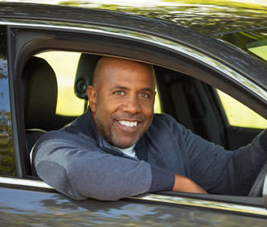
REMEMBER….
No accident is too small to report
Your safe driving does make a difference
Risk Management is always here to help
Notes:
In conclusion, Remember, no accident is too small to report.
Your safe driving makes a difference.
Most County vehicle have GPS which track a driver going 10 miles or more over the speed limit for over 4 minutes and it also tracks if a vehicle is stopped and idling for more than an hour.
And lastly, Risk Management is always here to help, so don’t ever hesitate contacting us.
Now I’ll turn it over to Terry to discuss TAT, and then answer your questions.

Slide 19
What is
T.A.T.?

Slide 20
QUESTIONS?

Slide 23

BE
AWARE...
County Vehicle LOGO
GPS
  Driving 10 miles over the speed limit for 4 miles or more
  Leaving your vehicle idling for more than 60 minutes.

Slide 24
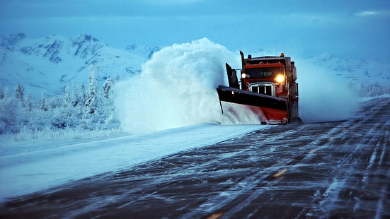
SNOW FORMS

Slide 25
Vehicle Accident Report-page 1
Notes:
Also in your packet is the Vehicle Accident Report for you to complete. It is pretty straight forward.
This is something you will complete either at the scene or right when you get back to the office. Remember to put your work address and phone number.
This is an internal document, so you will not share it with the other party or have them complete any part of it.

Slide 26
Employee Driver’s License and Automobile Insurance Tracking
1. Placer County Vehicle Use Agreement.
2. Use of Private Vehicle on Official
Business Waiver
3. Use of Private Vehicle on Official Business Employee Insurance Information
* Job Aide--Workday – Maintain License/Auto Insurance and/or Certification Information

